Slide 1
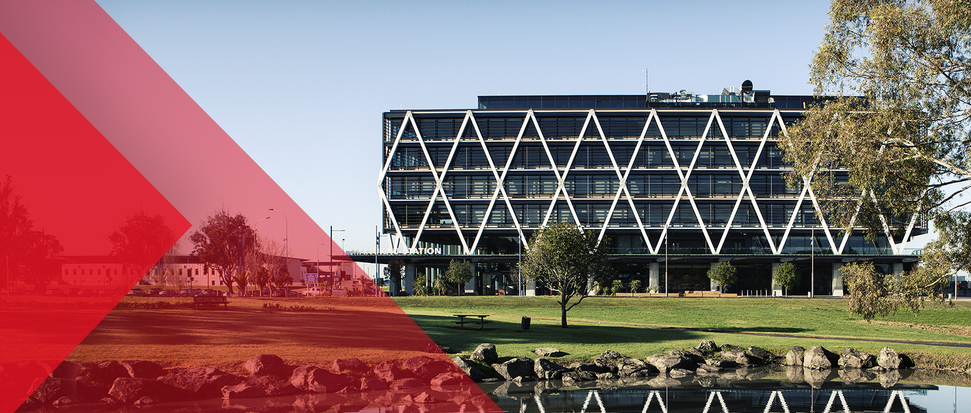
Cloud Computing for Software Developers
01: Introduction to Cloud Computing
Tim Long

Slide 2
What is Cloud Computing? - Definitions
In the simplest terms, cloud computing means storing and accessing data and programs over the Internet instead of your computer's hard drive.
Cloud computing is a form of Internet-based computing that provides shared computer processing resources and data to computers and other devices on demand.^{[1]} It is a model for enabling on-demand access, from work, home and other locations, to a shared pool of configurable computing resources (e.g., computer networks, servers, storage, applications and services),^{[2][3]} which can be rapidly provisioned and released with minimal management effort
Simply put, cloud computing is the delivery of computing services—servers, storage, databases, networking, software, analytics and more—over the Internet (“the cloud”). Companies offering these computing services are called cloud providers and typically charge for cloud computing services based on usage, similar to how you are billed for water or electricity at home.

Slide 3
Summary
Over the internet – not local storage
Shared resources
Elastic resources—Scale up or down quickly and easily to meet demand
Metered service so you only pay for what you use
Self service—All the IT resources you need with self-service access

Slide 4
Uses of Cloud Computing
Create new apps and services
Store, back up and recover data
Host websites and blogs
Stream audio and video
Deliver software on demand
Analyse data for patterns and make predictions

Slide 5
Top benefits of cloud computing
Cost
Cloud computing eliminates the capital expense of buying hardware and software and setting up and running on-site datacenters—the racks of servers, the round-the-clock electricity for power and cooling, the IT experts for managing the infrastructure. It adds up fast.
Speed
Most cloud computing services are provided self service and on demand, so even vast amounts of computing resources can be provisioned in minutes, typically with just a few mouse clicks, giving businesses a lot of flexibility and taking the pressure off capacity planning.
Global scale
The benefits of cloud computing services include the ability to scale elastically. In cloud speak, that means delivering the right amount of IT resources—for example, more or less computing power, storage, bandwidth—right when its needed and from the right geographic location.

Slide 6
Top benefits of cloud computing
Productivity
On-site datacenters typically require a lot of “racking and stacking”—hardware set up, software patching and other time-consuming IT management chores. Cloud computing removes the need for many of these tasks, so IT teams can spend time on achieving more important business goals.
Performance
The biggest cloud computing services run on a worldwide network of secure datacenters, which are regularly upgraded to the latest generation of fast and efficient computing hardware. This offers several benefits over a single corporate datacenter, including reduced network latency for applications and greater economies of scale.
Reliability
Cloud computing makes data backup, disaster recovery and business continuity easier and less expensive, because data can be mirrored at multiple redundant sites on the cloud provider’s network.

Slide 7
Types of cloud services
Types of cloud services: IaaS, PaaS, SaaS
Most cloud computing services fall into three broad categories: infrastructure as a service (IaaS), platform as a service (PaaS), and software as a service (Saas).
These are sometimes called the cloud computing stack, because they build on top of one another. Knowing what they are and how they’re different makes it easier to accomplish your business goals.

Slide 8
What is IaaS
The most basic category of cloud computing services. With IaaS, you rent IT infrastructure—servers and virtual machines (VMs), storage, networks, operating systems—from a cloud provider on a pay-as-you-go basis.
Infrastructure as a service (IaaS) is an instant computing infrastructure, provisioned and managed over the Internet. Quickly scale up and down with demand, and pay only for what you use.
IaaS helps you avoid the expense and complexity of buying and managing your own physical servers and other datacenter infrastructure. Each resource is offered as a separate service component, and you only need to rent a particular one for as long as you need it. The cloud computing service provider manages the infrastructure, while you purchase, install, configure, and manage your own software—operating systems, middleware, and applications.

Slide 9
Advantages of IaaS
Eliminates capital expense and reduces ongoing cost. IaaS sidesteps the upfront expense of setting up and managing an on-site datacenter, making it an economical option for start-ups and businesses testing new ideas.
Improves business continuity and disaster recovery. Achieving high availability, business continuity, and disaster recovery is expensive, since it requires a significant amount of technology and staff. But with the right service level agreement (SLA) in place, IaaS can reduce this cost and access applications and data as usual during a disaster or outage.
Innovate rapidly. As soon as you’ve decided to launch a new product or initiative, the necessary computing infrastructure can be ready in minutes or hours, rather than the days or weeks—and sometimes months—it could take to set up internally.
Respond quicker to shifting business conditions. IaaS enables you to quickly scale up resources to accommodate spikes in demand for your application— during the holidays, for example—then scale resources back down again when activity decreases to save money.
Focus on your core business. IaaS frees up your team to focus on your organization’s core business rather than on IT infrastructure.
Increase stability, reliability, and supportability. With IaaS there’s no need to maintain and upgrade software and hardware or troubleshoot equipment problems. With the appropriate agreement in place, the service provider assures that your infrastructure is reliable and meets SLAs.
Better security. With the appropriate service agreement, a cloud service provider can provide security for your applications and data that may be better than what you can attain in-house.
Gets new apps to users faster. Because you don’t need to first set up the infrastructure before you can develop and deliver apps, you can get them to users faster with IaaS.

Slide 10
What is PaaS
Platform-as-a-service (PaaS) refers to cloud computing services that supply an on-demand environment for developing, testing, delivering, and managing software applications. PaaS is designed to make it easier for developers to quickly create web or mobile apps, because it is easier to set up the underlying infrastructure of servers, storage, network, and databases needed for development.
PaaS includes infrastructure—servers, storage, and networking—but also middleware, development tools, business intelligence (BI) services, database management systems, and more. PaaS is designed to support the complete web application lifecycle: building, testing, deploying, managing, and updating.
PaaS allows you to avoid some of the expense and complexity of buying and managing software licenses, the underlying application infrastructure and middleware or the development tools and other resources. You manage the applications and services you develop, and the cloud service provider typically manages everything else.

Slide 11
What is SaaS
Software-as-a-service (SaaS) is a method for delivering software applications over the Internet, on demand and typically on a subscription basis. With SaaS, cloud providers host and manage the software application and underlying infrastructure, and handle any maintenance, like software upgrades and security patching. Users connect to the application over the Internet, usually with a web browser on their phone, tablet, or PC
Software as a service (SaaS) allows users to connect to and use cloud-based apps over the Internet. Common examples are email, calendaring, and office tools (such as Microsoft Office 365).
SaaS provides a complete software solution that you purchase on a pay-as-you-go basis. You rent the use of an app for your organization, and your users connect to it over the Internet, usually with a web browser. All of the underlying infrastructure, middleware, app software, and app data are located in the service provider’s data center. The service provider manages the hardware and software, and with the appropriate service agreement, will ensure the availability and the security of the app and your data as well. SaaS allows your organization to get quickly up and running with an app at minimal upfront cost.

Slide 12
Advantages of SaaS
Gain access to sophisticated applications. To provide SaaS apps to users, you don’t need to purchase, install, update, or maintain any hardware, middleware, or software. SaaS makes even sophisticated enterprise applications, such as CRM, affordable for organizations that lack the resources to buy, deploy, and manage the required infrastructure and software themselves.
Use free client software. Users can run most SaaS apps directly from their web browser without needing to download and install any software, although some apps require plugins. This means that you don’t need to purchase and install special software for your users.
Mobilize your workforce easily. SaaS makes it easy to “mobilize” your workforce because users can access SaaS apps and data from any Internet-connected computer or mobile device. A carefully chosen service provider will ensure the security of your data, regardless of the type of device consuming it.
Access app data from anywhere. With data stored in the cloud, users can access their information from any Internet-connected computer or mobile device. And when app data is stored in the cloud, no data is lost if a user’s computer or device fails.

Slide 13
Exercise - Group these systems: IaaS or PaaS or SaaS or Not-Cloud?
Briefly google the following services and decide which category they are:
Citrix
Azure
Google Drive
Azure Active Directory
Xero
AWS Elastic Beanstalk
Google Compute Engine
SalesForce
Prey
MYOB Essentials
Dropbox
World of Warcraft
Google Chrome
Eclipse
Wordpress (Admin)
Wordpress (End User)
Thonny
Adobe Photoshop

Slide 14
Emerging cloud technologies and services
Serverless
With serverless computing, developers simply create code, and the cloud provider loads and executes that code in response to real-world events.
Users don't have to worry about the server or instance aspect of the cloud deployment. Users only pay for the number of transactions that the function executes.
Examples: AWS Lambda, Google Cloud Functions and Azure Functions
Big Data processing
Enormous compute resources for relatively short durations.
Examples : Google BigQuery for large-scale data warehousing and Microsoft Azure Data Lake Analytics for processing huge data sets.
artificial intelligence (AI) and machine learning.
These technologies build machine understanding, enable systems to mimic human understanding and respond to changes in data to benefit the business.
Examples: Amazon Machine Learning, Amazon Lex, Amazon Polly, Google Cloud Machine Learning Engine and Google Cloud Speech API are examples of these services.

Slide 15
Cloud Categories
Public Cloud
Private Cloud
Hybrid cloud
Community cloud
Distributed cloud

Slide 16
Public Cloud
Public clouds are owned and operated by companies that offer rapid access over a public network to affordable computing resources. With public cloud services, users don’t need to purchase hardware, software, or supporting infrastructure, which is owned and managed by providers.
Key aspects of public cloud
Innovative SaaS business apps for applications ranging from customer resource management (CRM) to transaction management and data analytics
Flexible, scalable IaaS for storage and compute services on a moment’s notice
Powerful PaaS for cloud-based application development and deployment environments

Slide 17
Private Cloud
A private cloud is infrastructure operated solely for a single organization, whether managed internally or by a third party, and hosted either internally or externally. Private clouds can take advantage of cloud’s efficiencies, while providing more control of resources and steering clear of multi-tenancy.
Key aspects of private cloud
A self-service interface controls services, allowing IT staff to quickly provision, allocate, and deliver on-demand IT resources
Highly automated management of resource pools for everything from compute capability to storage, analytics, and middleware
Sophisticated security and governance designed for a company’s specific requirements

Slide 18
Hybrid Cloud
A hybrid cloud uses a private cloud foundation combined with the strategic integration and use of public cloud services. The reality is a private cloud can’t exist in isolation from the rest of a company’s IT resources and the public cloud. Most companies with private clouds will evolve to manage workloads across data centers, private clouds, and public clouds—thereby creating hybrid clouds.
Key aspects of hybrid cloud
Allows companies to keep the critical applications and sensitive data in a traditional data center environment or private cloud
Enables taking advantage of public cloud resources like SaaS, for the latest applications, and IaaS, for elastic virtual resources
Facilitates portability of data, apps and services and more choices for deployment models

Slide 19
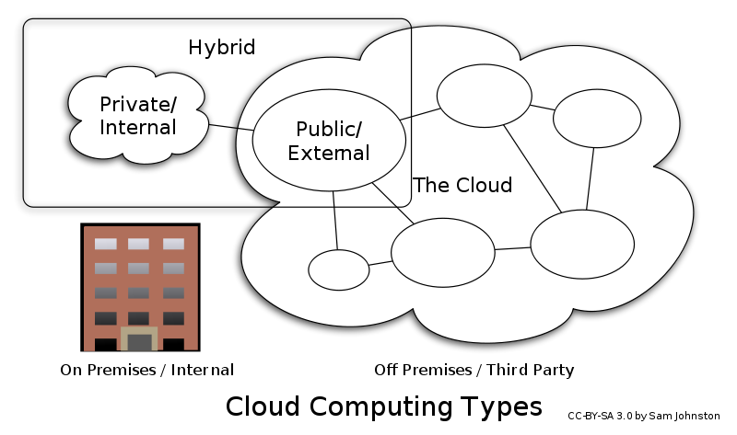
Hybrid Cloud

Slide 20
Community Cloud
Community cloud shares infrastructure between several organizations from a specific community with common concerns (security, compliance, jurisdiction, etc.), whether managed internally or by a third-party, and either hosted internally or externally.
The costs are spread over fewer users than a public cloud (but more than a private cloud), so only some of the cost savings potential of cloud computing are realized.

Slide 21
Distributed Cloud
A cloud computing platform can be assembled from a distributed set of machines in different locations, connected to a single network or hub service. It is possible to distinguish between two types of distributed clouds: public-resource computing and volunteer cloud.
Public-resource computing—distributed computing. Examples include:
BOINC
Folding@Home.
Volunteer cloud—a cloud computing infrastructure is built using volunteered resources.
Challenges arise from this type of infrastructure, because of the volatility of the resources used to built it and the dynamic environment it operates in.
Cloud@Home

